Slide 1
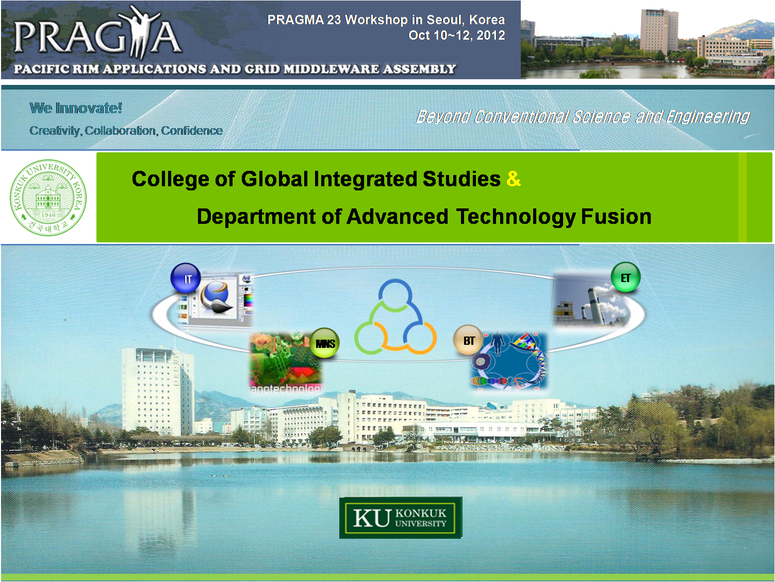

Slide 2


Ⅰ
Konkuk University
Ⅱ
College of Global Integrated Studies
Ⅲ
Department of
Advanced Technology Fusion
Ⅳ
Needs for International Relationship

Slide 3

Konkuk University
College of Global Integrated Studies
Department of Advanced Technology Fusion
Needs for International Relationship

Slide 4
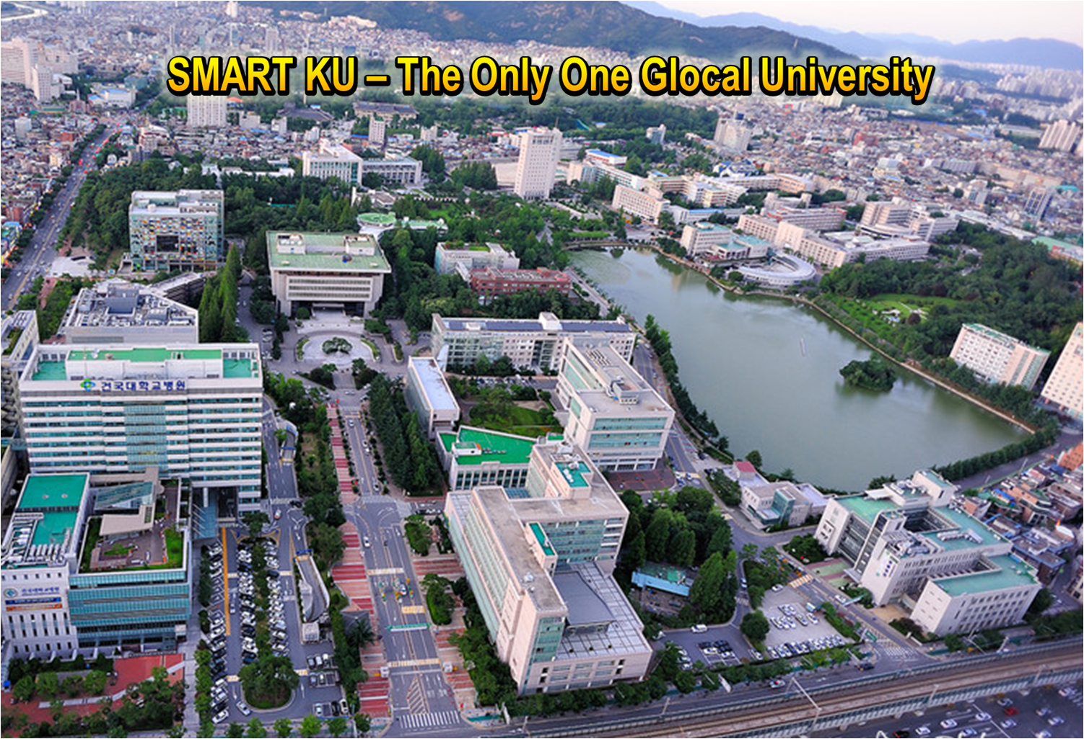
Konkuk University - Seoul Campus, Korea
1

Slide 5
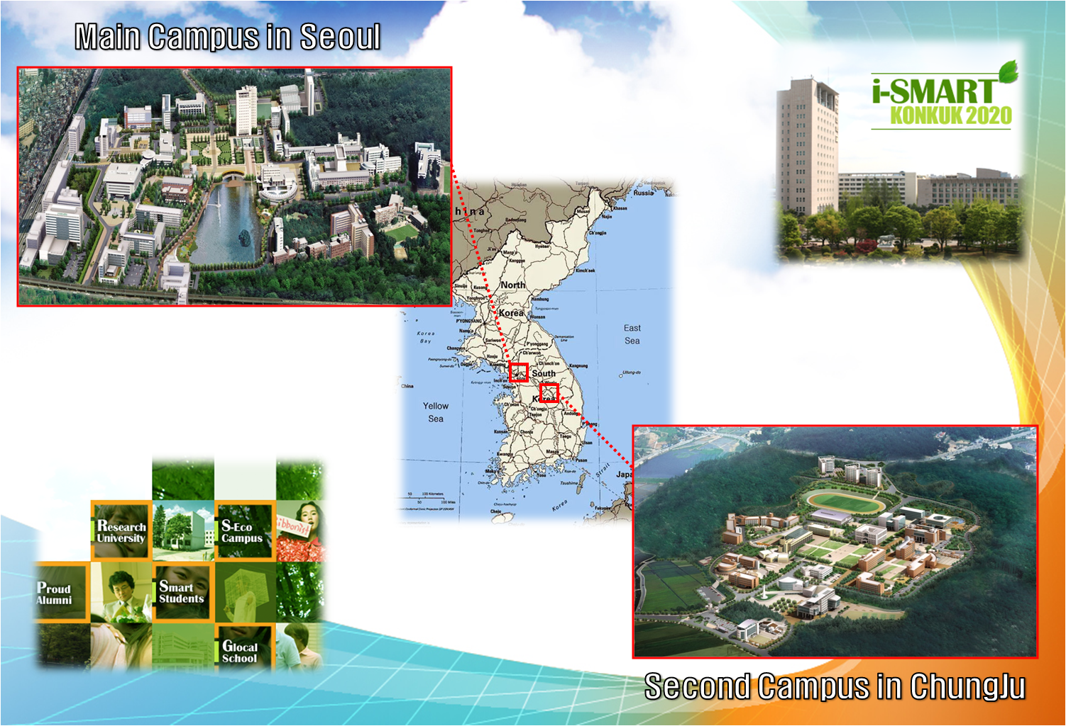
Konkuk University – Campus Overview
2

Slide 6


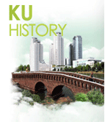
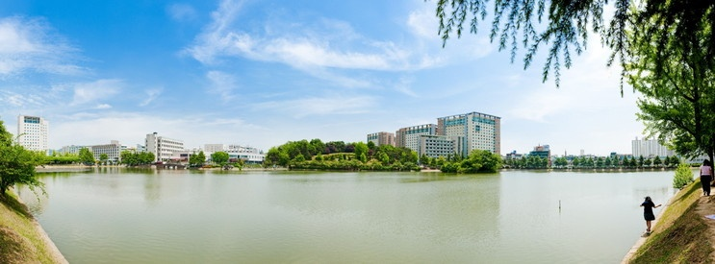
Konkuk University – Brief History
3
In
1946
In 1946, The Chosun Political School, the forerunner of
Konkuk University, was founded by Dr. Suk-Chang Yoo
In
1959
In 1959, the school was renamed Konkuk University.
In
1980
In 1980, a second campus was opened in Chungju City.
([Change of Name] In 2011, Chungju Campus → Glocal Campus)
In
2012
In 2012, Dr. Song, Hee Young inaugurated as the 19th president.

Slide 7




Konkuk University
4
Top
Total
Ranking
Top
13
2
Development
Rate
Top
Top
2
2
Employment
Rate
Top
Top
2
5
Research
Grants
Top
Top
3
7

Slide 8



Konkuk University – Facts and Figures
5
Students
Faculty
Staff
21,000 undergraduates
4,000 postgraduates
1,000 full-time professors
1,300 part-time instructors
500 staff members
Offering 112 bachelor’s, 67 master’s, and 58 doctoral degrees,
with 20 colleges and 12 specialized graduate schools.

Slide 9




Konkuk University – Globalization
6
300 partner universities/institutions in 48 countries
Over 150 incoming exchange students every year.
Over 400 KU students going abroad every year.
Active Partner Universities
Europe
Asia/Australia
Americas
University of Edinburgh
University of Basel
Sodertorns University
IESEG School of Management
University of Groningen
Erasmus Univ. of Rotterdam
University of Leicester
GSO University of Applied
Sciences Nuremberg
University of Florence
NTNU, Norway
University of Southern Denmark
Haaga-Helia University
University of Málaga
Chongqing University
Nanjing University
Sichuan University
Wuhan University
Shanghai University of F&E
Chuo University
Osaka University
Toyo University
Matsuyama University
Murdoch University
Univ. of the Sunshine Coast
University of Tasmania
VIT University
Institut Teknologi Bandung
Chulalongkorn University
SUNY, Stony Brook
Univ. of California, Davis
University of Pittsburg
Virginia Tech University
Texas A&M University
University of Mississippi
Hawaii Pacific University
University of Nebraska, Lincoln
Vanderbilt University
University of Alberta
University of Victoria
University Francisco Marroquin
La Universidad Nacional de
Columbia

Slide 10
Konkuk University – Academics
7
Colleges
Specialized
Graduate Schools
Global Integrated Studies
Science
Architecture
Engineering
Information and Telecommunication
Political Science & Law
Liberal Arts
Commerce and Economics
Business Administration
Animal Bioscience and Technology
Life and Environmental of Science
Veterinary Medicine
Art and Design
Education
Architecture
Medicine
Public
Administration
Education
Engineering
Business Administration
Agriculture and Animal Science
Communication and Public Relations
Information and Telecommunications
Design
Real Estate

Slide 11
Konkuk University
College of Global Integrated Studies
Department of Advanced Technology Fusion
Needs for International Relationship

Slide 12
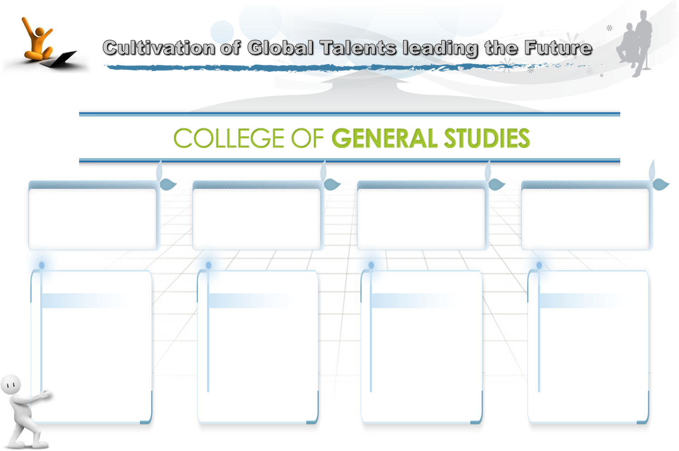
College of Global Integrated Studies
8
Division of
Interdisciplinary
Studies
Division of
International
Studies
Division of
Specialized
Studies
Division of
Advanced Industry
Fusion
To educate
various
disciplines
such as
liberal arts,
science, and
engineering
To bring up
International
specialists
with
global mind
To nurture
outstanding talent in the field of Bioscience and Biotechnology
To cultivate
the knowledge
and strategy
on
new industries convergence

Slide 13
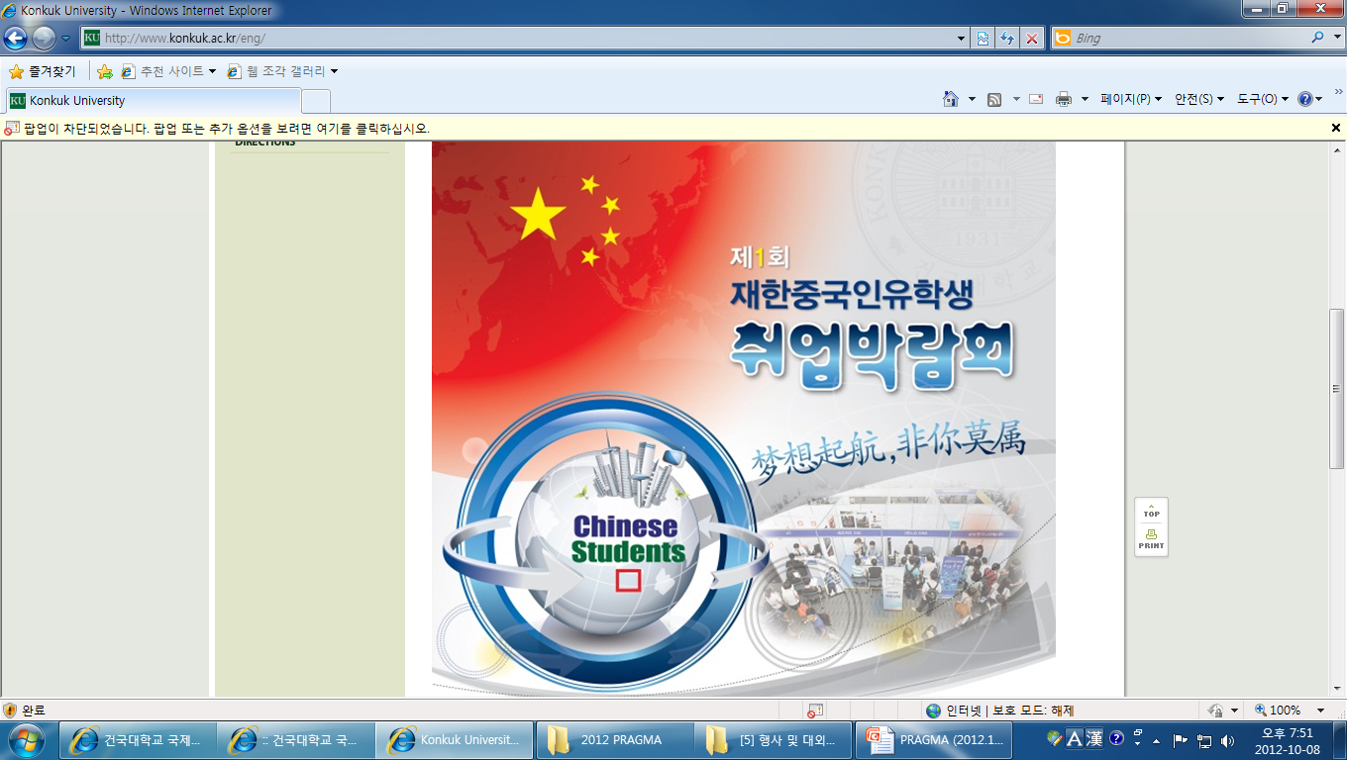


College of Global Integrated Studies
10
Department of Chinese Commerce and Business
Department of Chinese Commerce and Business,
newly established in September 2010, aims to
bring up China-centered International commercial
specialists.
Department has a uniquely specialized
curriculum in which a small elite group
of students, with bilingual (English and Chinese)
education receive dual degrees from Konkuk
University and Nanjing University in China.
Focus on China
Humanist · Generalist,
Glocalizer · Specialist

Slide 14
College of Global Integrated Studies
9
Division of International Studies
Cultivation of international specialists with global mind
Recruiting & management of excellent foreign students & researchers
Development & Operation of global curriculums

Slide 15
Konkuk University
College of Global Integrated Studies
Department of Advanced Technology Fusion
Needs for International Relationship

Slide 16
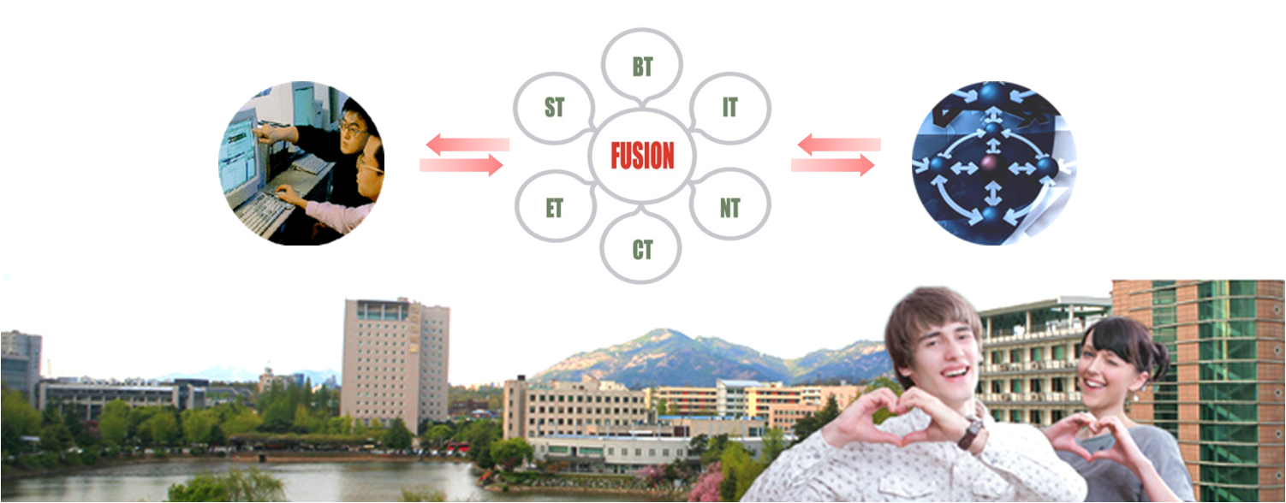
Introduction
12
The first Ph.D. degree program in the e-Science based technology fusion
• is offered by Konkuk University (which we call u-Science based advanced technology fusion, hereinafter just u-Science). It is one of the most ambitious and innovative education programs in technology fusion in the world.
Brain Korea 21 Award for Graduate Program of Excellence
• The u-Science program has received a BK21 award from the Korean Ministry of Education and Human Resources Development in 2006. It is awarded one and half million dollars every year through 2012.
• The main goal of the BK21 project (http://www.bk21.or.kr) is to select graduate programs with potentials for world-class education and research competitiveness and to support them to achieve their potentials in both finance and administration. The BK21 project usually awards five to ten graduate programs in each scientific or engineering area.

Slide 17



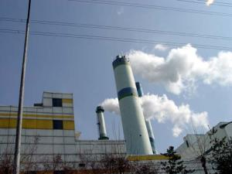
Strategies & Focus
13
Specialization in Ubiquitous Technology
• ubiquitous technology focused e-Science
• world-wide leading research group in the u-Science area
• system integration, data management, embedded software, multimedia
Specialization in Intelligent Micro & Nano System (iMNS)
Technology
• advanced sensors, batteries and microrobots
• aerospace/mechanical engineering, intelligent nano/micro system
Specialization in Intelligent Biotechnology (iBT)
• genetic engineering technology
• on BT-based technology application for IT, ET, and MS. iBT group
Specialization in Environmental Technology (u-Environment)
• to integrate monitoring, data management, and data analyses in real time manner
• civil engineering (u-GIS, u-City etc.)
• environmental engineering (air, water, soil etc.)

Slide 18
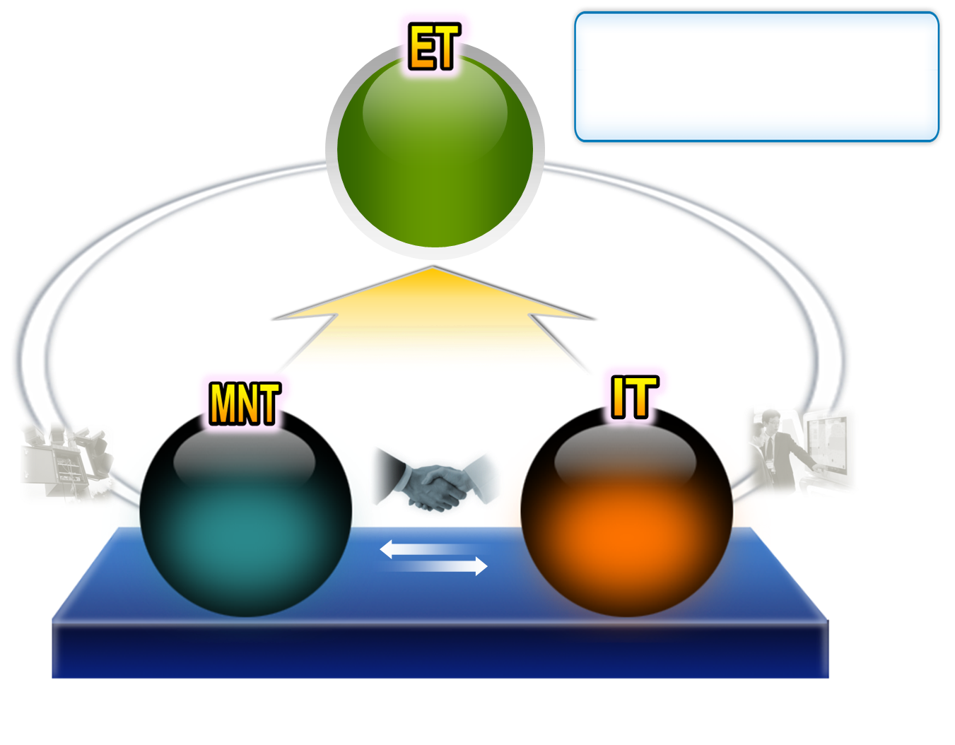
Strategies & Focus
14
ET : Environmental Technology
IT : Information Technology
MNT : Micro System & Nano Technology
We plan to make a world-leading professionals in this areas
Environment, Green Growth, Smart City, New Regeneration Energy
Integration of
Platform & Application
Ubiquitous Science
( u-Science )
Sensors, Batteries,
Solar Cell Microrobots
Nano
System Integration,
Data Management,
AR
(Augmented Reality),
Embedded S/W
Inter-platform Integration
Next Generation Wireless Communication ( Wibro, BCN, RFID, USN )

Slide 19
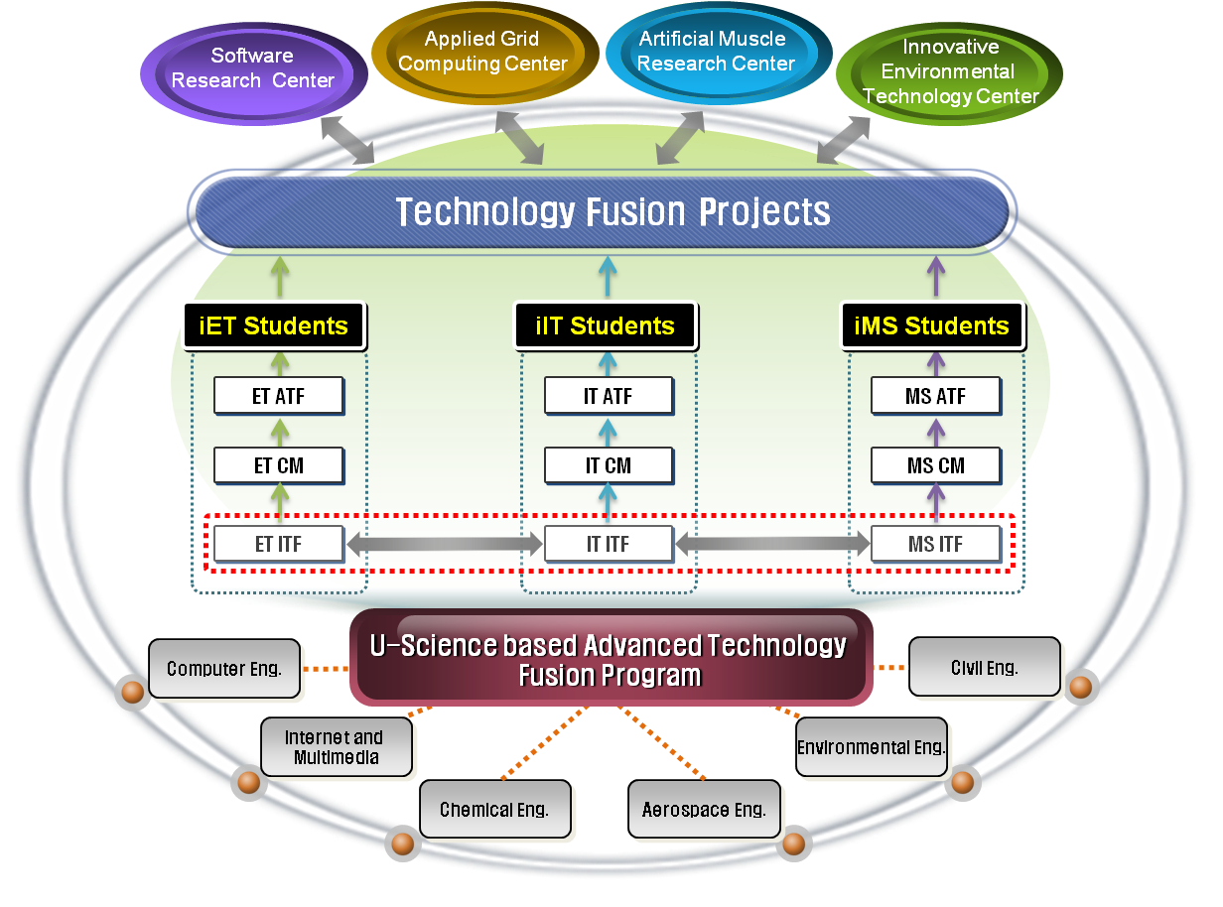
Curriculum
16
iET Students
iIT Students
iMNS Students
MNS ATF
MNS CM
MNS ITF
ATF : Advanced Technology Fusion Courses
CM : Conventional Major Courses
ITF : Introduction Technology Fusion Courses

Slide 20

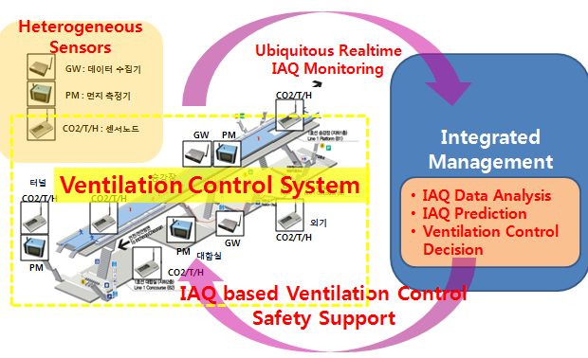

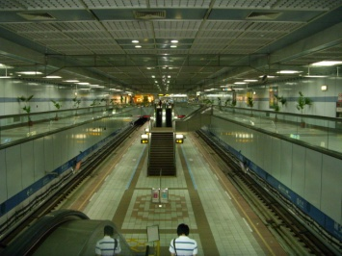
Example of Technology Fusion
22
Seoul Metro Integrated Management System for Intelligent & Energy-efficient Indoor Air Quality Monitoring & Control
Manager : Kim, Jo Chun (Prof.)
Cost : 1,187,530 USD
Ubiquitous Sensor Network
Integrated Management System
Intelligent & Energy-Efficient
IT+ET+MS Technology Fusion
Auto Ventilation Control System in
Subway Station

Slide 21

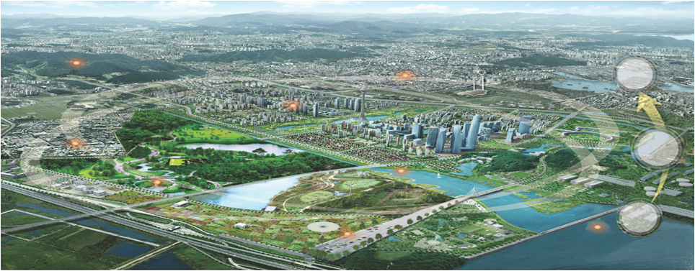
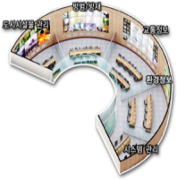

Example of Technology Fusion
21
Research & Development Project for u-ECO City
Manager : Pyon, Mu Wook (Prof.)
Cost : 1,066,350 USD
Ubiquitous space
World’s first IT based City
IT+ET+CT+Energy saving technology
Eco City
Real-time DB management
Urban Energy Integrated Center
Forest Fire Sensor
U-House
space service
Application of Information
CCTV
Urban Integrated Operating Center
Wire Network
Urban Environmental Ecology Design
CCTV
Information Processing
Wire-less
Network
USN
Bridge Safety supervision system
Integrated Information of Water Recycle
Safety supervision system
Environmental pollution, Water quality

Slide 22

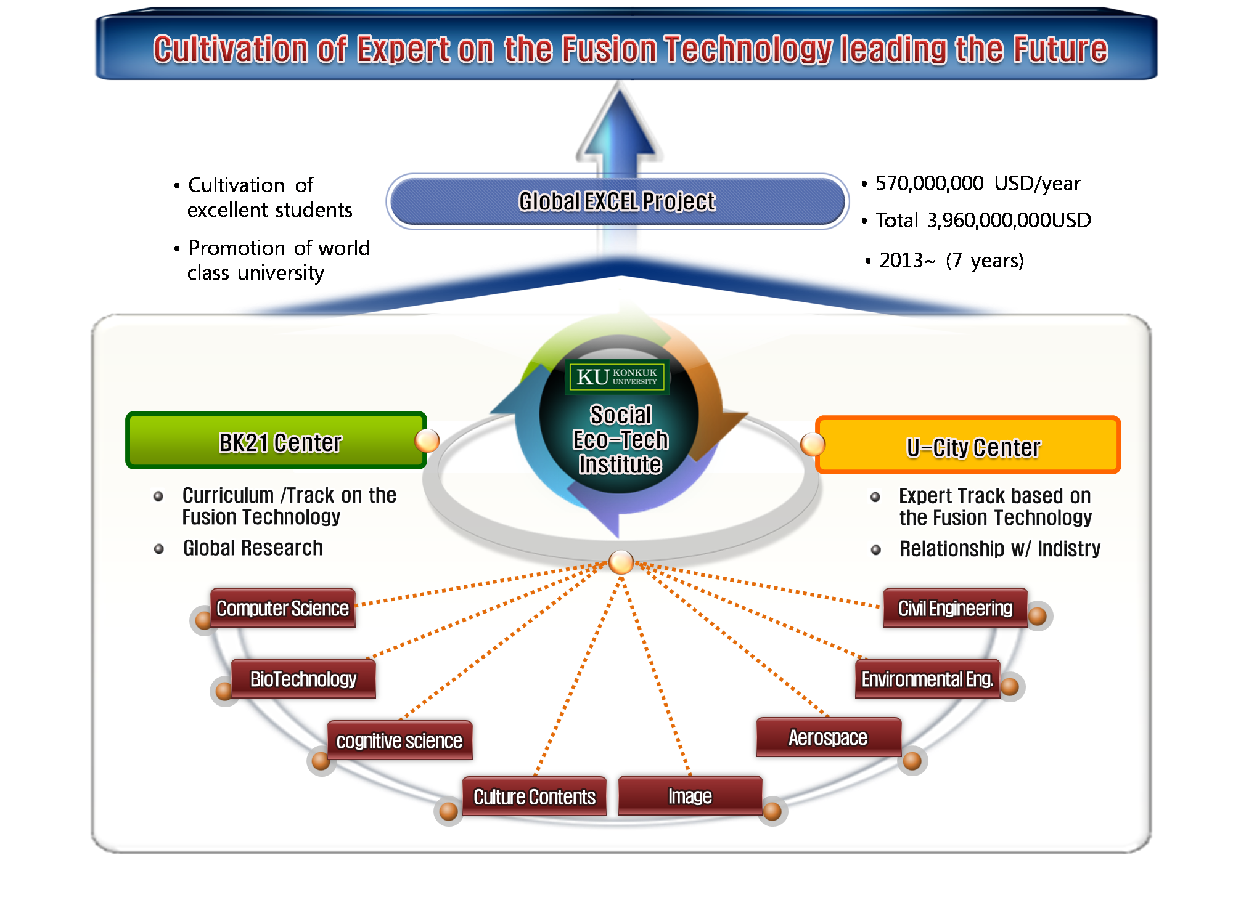





Social Eco-Tech Institute
24
Research Fields
Services on the air environment information that help support the vulnerable members of environment
Services on the game type education that help support the vulnerable members of emotion
Services on the reactive motion type health improvement that help support the vulnerable members of exercise

Slide 23
Konkuk University
College of Global Integrated Studies
Department of Advanced Technology Fusion
Needs for International Relationship

Slide 24


National Project for Financial Support in Korea
25
• Reinforcement of
education capability
• Reinforcement of
research capability
• Cultivation of
excellent students
• Recruit of excellent
foreign researchers
• Promotion of world
class university
• 2006~ (7 years)
• 2008~ (5 years)
• 2013~ (7 years)
• 180,000,000 USD/year
• 149,000,000 USD/year
• 570,000,000 USD/year
• Total 1,260,000,000USD
• Total 740,000,000USD
• Total 3,960,000,000USD
• SCI(E)
• SCI(E)
• SCI(E)
• Globalization by
foreign researchers
• Globalization of
graduate students
Source : 1) Ministry of Educational Science and Technology, 2) National Research Foundation of Korea
BK21 (Brain Korea 21)
WCU (World Class University )
Global EXCEL(Excellence and Competitiveness Endeavor for Leading Universities)

Slide 25
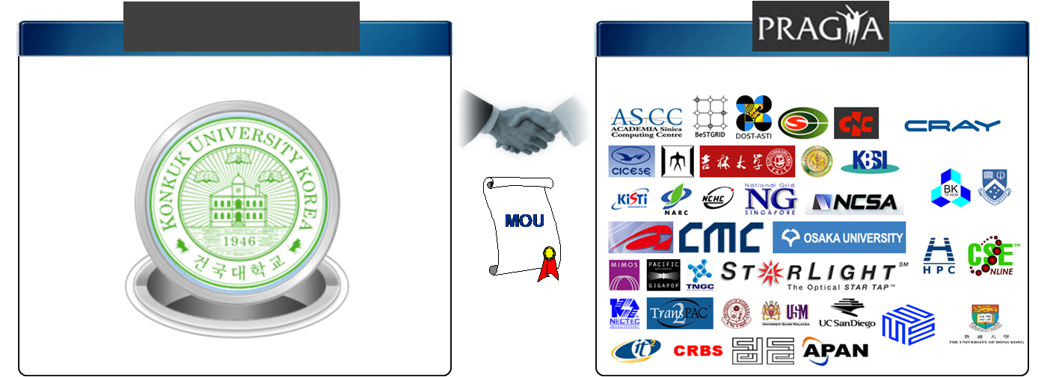







Needs & Benefits of international cooperation
26
Konkuk University
Institutional Members
Global Education & Research by International cooperation

Slide 26


Slide 27



OKTOBERFEST in KOREA
27
PRAGMA Finale & Farewell
October 11, 2012 (Th) 6 p.m.
Star Lounge
@ Star City

